Slide 1
AIRBNB new user booking prediction
K Prasanth

Slide 2
AGENDA
Introduction
Data Wrangling
EDA
Models Used
Summary

Slide 3
INTRODUCTION
New users on Airbnb can book a place to stay in 34,000+ cities across 190+ countries. By accurately predicting where a new user will book their first travel experience, Airbnb can share more personalized content with their community, decrease the average time to first booking, and better forecast demand.

Slide 4
PRIMARY GOALS
Clean the data by removing outlier and invalid data.
Get insight, uncover patterns and relations.
Create a predictive model which is more stable with new data.

Slide 5
Data wrangling
Sessions dataset has details about all sessions made by users.
Grouping the table based on users and counting the actions and time spent by each user.
sessions_df = sessions_df.groupby('user_id')
sessions_df = sessions_df.agg({'action':'count','secs_elapsed':'sum’})
Merging the train and sessions dataset to use it as single train set.
Same followed for test set but without target value.
train_users_df = pd.merge(left=train_users_df,
right=sessions_df,left_on='id’,
right_on='user_id',how='left')

Slide 6
Data wrangling
Changing the unknow value to Nan values in gender.
train_users_df['gender'] = train_users_df['gender'].replace
('-unknown-',np.nan)
Removing invalid values from age column.
train_users_df.loc[train_users_df['age']>100,'age'] = np.nan
Feature engineering age column and action column to make it as categorical.
age_mapping = {i: i // 5 for i in range(101)}
train_users_df['age_bucket']=train_users_df['age’].map(age_mapping)
action_mapping = {i: i // 50 for i in range(3000)}
train_users_df['action_bucket']= train_users_df['action’]
.map(age_mapping)

Slide 7
Data wrangling
Removing all unwanted columns and columns used to create other columns.
train_users_df.drop('age',axis=1,inplace=True)
train_users_df.drop('timestamp_first_active',axis=1,inplace=True)
train_users_df.drop('action',axis=1,inplace=True)
train_users_df.drop('date_account_created',axis=1,inplace=True)
train_users_df.drop('secs_elapsed',axis=1,inplace=True)
train_users_df.drop('date_first_booking',inplace=True,axis=1)

Slide 8
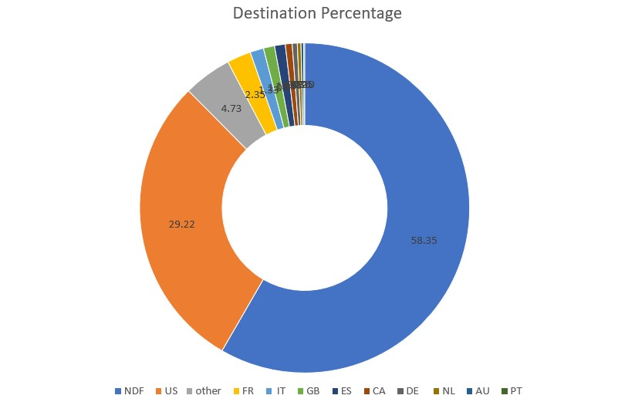
Exploratory Data Analysis

Slide 9
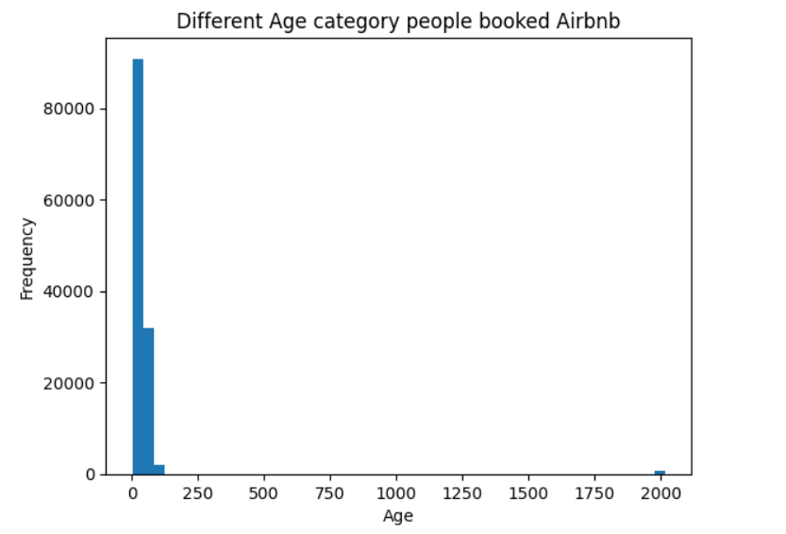
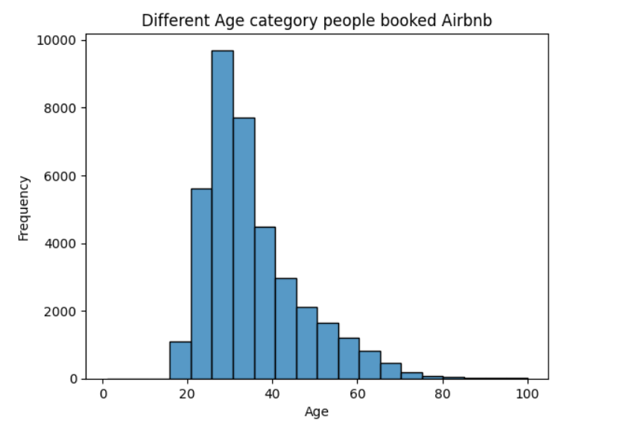
Exploratory Data Analysis

Slide 10
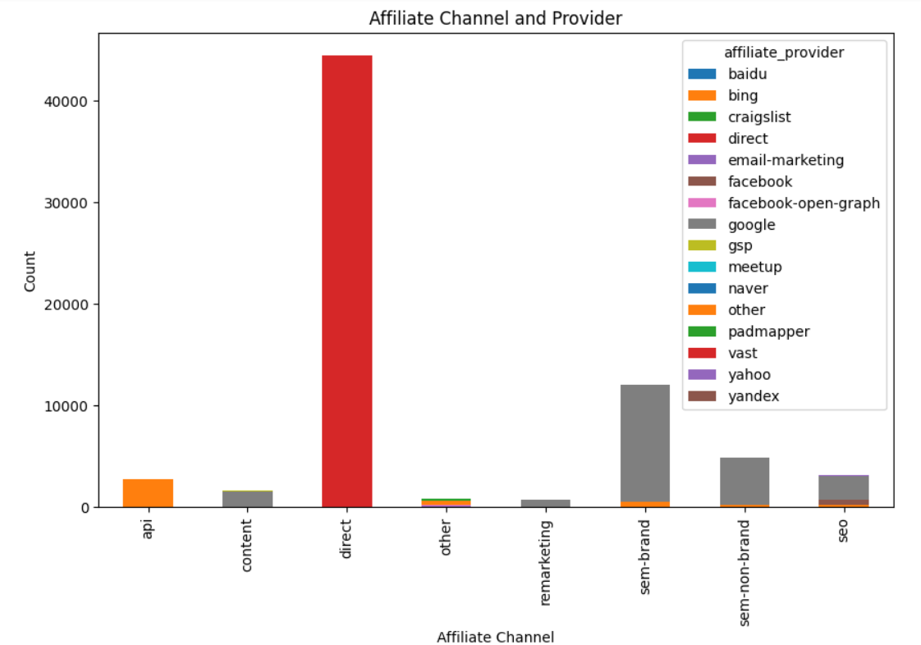
Exploratory Data Analysis

Slide 11
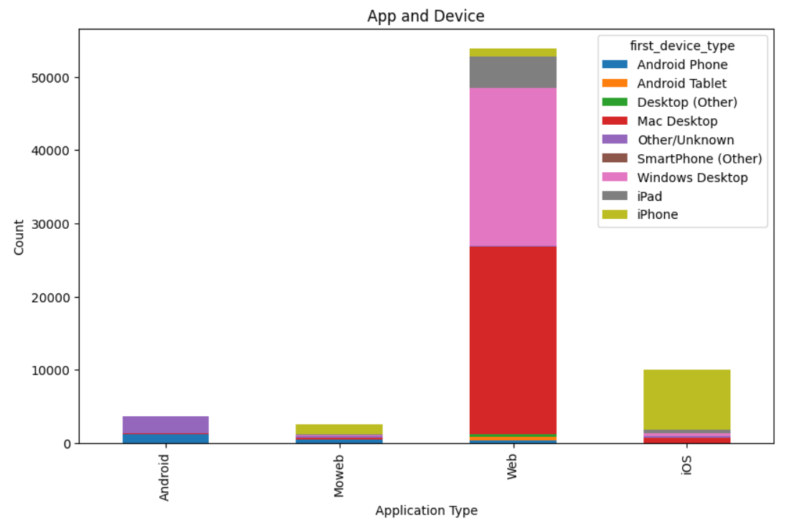
Exploratory Data Analysis

Slide 12
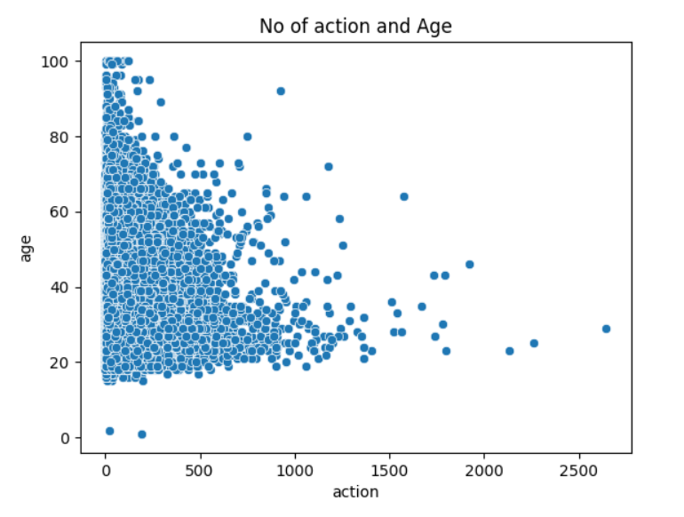
Exploratory Data Analysis

Slide 13
Feature and Target
We split the dataset into train and validate, train set is used to fit the model and validate is used to find the accuracy of the model
train, validate = train_test_split(final_df,train_size=0.8,random_state=41)
It is then further divided in to feature and target by using features we are going to predict the target.
X_train = train.drop(['country_destination'],axis=1)
y_train = train['country_destination’]
X_validate = validate.drop(['country_destination'],axis=1)
y_validate = validate['country_destination']

Slide 14
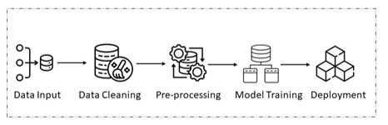
Building Models
For this challenge two predictive models are used Decision Tree and Random Forest

Slide 15
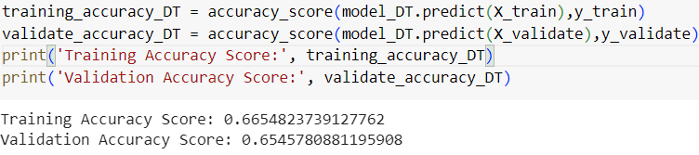
Decision Tree AND ITS Accuracy
from sklearn.tree import DecisionTreeClassifier
from sklearn.pipeline import make_pipeline
model_DT = make_pipeline(ce.OrdinalEncoder(),SimpleImputer(strategy="mean"),
StandardScaler(),DecisionTreeClassifier(random_state=41,max_depth=8,max_features=9))
model_DT.fit(X_train,y_train)
Validating the accuracy for the model using accuracy score
from sklearn.metrics import accuracy_score

Slide 16
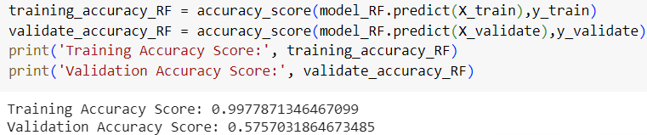
Random Forest AND ITS Accuracy
from sklearn.ensemble import RandomForestClassifier
model_RF = make_pipeline(ce.OrdinalEncoder(),SimpleImputer(strategy='most_frequent'),
StandardScaler(),RandomForestClassifier(random_state=41,n_estimators=40,max_features=10))
model_RF.fit(X_train,y_train)
Validating the accuracy for the model using accuracy score

Slide 17
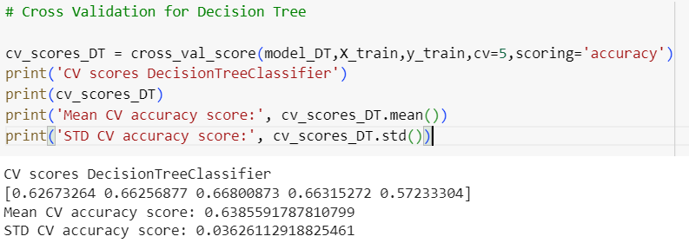
Handling Overfitting
Overfitting is, the model instead of understanding the patters and relations in the dataset it learnt the dataset so that when a new data introduced to predict it performs very poorly.
To handle this K-fold cross validation is used, it splits the dataset into K sets and in each iteration for training the model it removes one set from train data avoiding the model to get familiarize with train data.
from sklearn.model_selection import cross_val_score

Slide 18
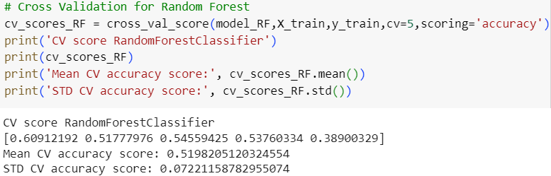
Handling Overfitting
It clearly shows Mean CV accuracy score for DT is higher than Random forest
Confirming for this prediction decision tree is performing better.

Slide 19
Hyper-parameter tuning
Hyperparameter tuning is the process of finding the optimal set of hyperparameters for a machine learning model to achieve better performance.
The goal of hyperparameter tuning is to search through a range of hyperparameter values and identify the combination that results in the best model performance.
This is typically done through an iterative process of training and evaluating the model with different hyperparameter values.
Common technique of hyper parameter tuning include grid search, randomised search, bayesian optimization, genetic algorithm, gradient-based optimization.

Slide 20
Hyper-parameter tuning
from sklearn.model_selection import RandomizedSearchCV
param_dist = {'simpleimputer__strategy':['mean','median','most_frequent’],
'decisiontreeclassifier__max_depth’:[8,9,10],
'decisiontreeclassifier__max_features': [8,9,10.11,12]}
final_model = RandomizedSearchCV(model_DT,param_dist,cv=3,scoring='accuracy')
final_model.fit(X_train,y_train)
best_score = final_model.best_score_
best_params = final_model.best_params_
print('Best score for `model`:', best_score)
print('Best params for `model`:', best_params)

Slide 21

Conclusion
When the Decision Tree model is used to with the hyperparameter values we got through Randomized search CV, we got below accuracy.
When we predicted the destination using the test data and submitted in Kaggle surprisingly we got score of 0.70125, which proves the model built is an stable one and has 70% accuracy in predicting the values.

Slide 22
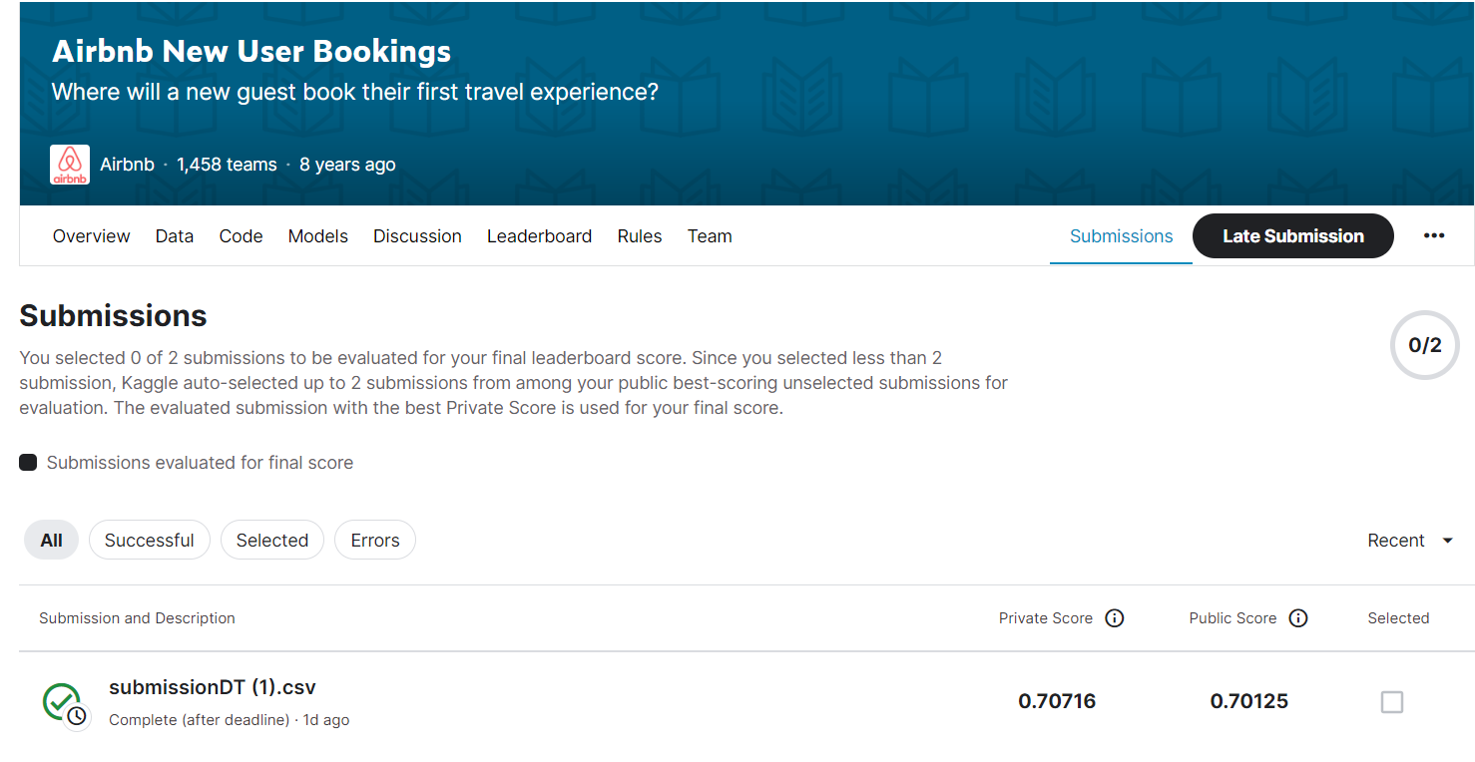

Slide 23
THANK YOU
K Prasanth

